Slide 1
Prehistory and Early History of the Hough Procedure Rome fragments
Pia Astone, Sergio Frasca, Cristiano Palomba

Slide 2
Early searches for periodic sources
1991 - Frasca-La Posta “Search for monochromatic sources with the GEOGRAV gravitational-wave antenna” (Il Nuovo Cimento 14C 1991, p.235-250):
GEOGRAV was a room temperature resonant bar gravitational antenna used to check the seismic, electromagnetic and gravimetric disturbances on the gravitational signal. We used 4 years of almost continuous data to search for periodic gravitational signals, in the band 856~859.3 Hz. We found an upper limit of about 3*10⁻²² .
1996 – «Search of Monochromatic gravitational waves using resonant detectors» P. Astone, S.Frasca, G.V.Pallottino, G.Pizzella:
Presentation of an algorithm for the search of periodic sources by the Explorer and Nautilus resonant low temperature gravitational antennas.

Slide 3
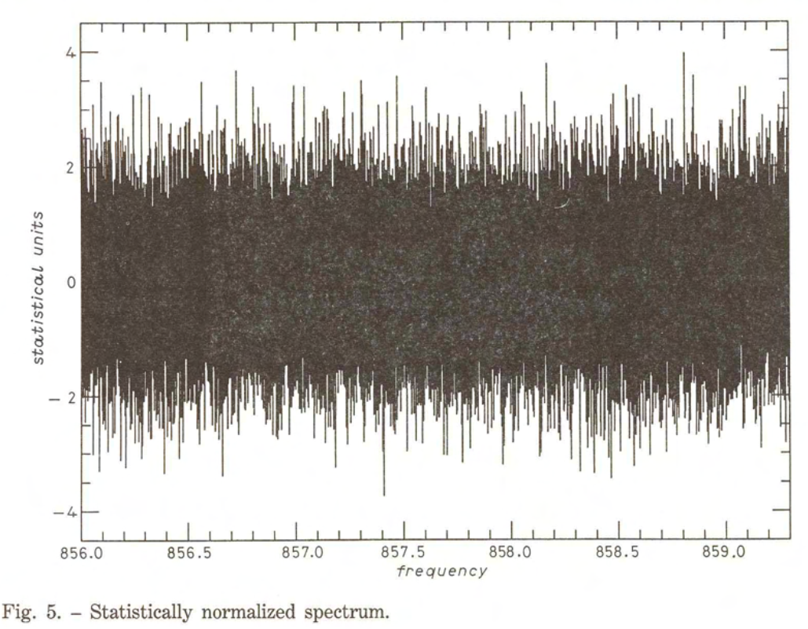
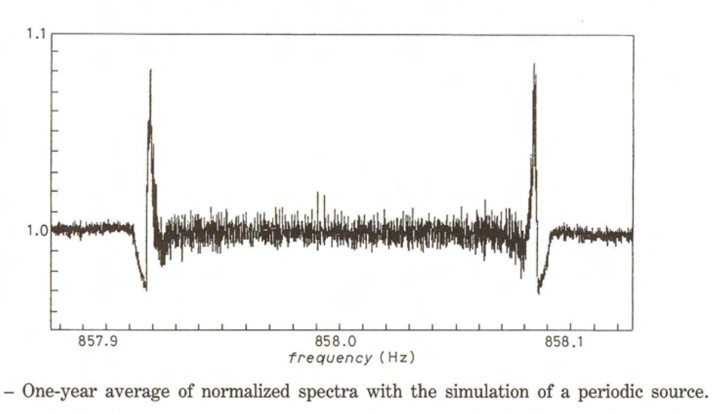
Geograv antenna data
The gravitational data were taken after a lock-in at the longitudinal resonance of the bar, giving a 1-Hz complex sequence.
Because the change of the temperature, there was a change in the frequency, that was computed in real time.

Slide 4
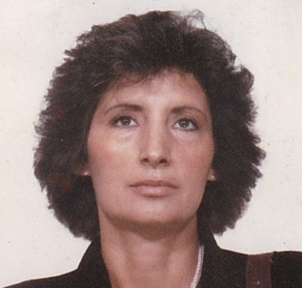
Starting the Virgo search for periodic sources
July 1997 : at a Virgo meeting in Paris, the Rome group was tasked with coordinating the search for periodic sources.
September 1997: Pia and Sergio went to Prof. Zanello. The idea was to use techniques for calculating bubble chamber tracks and apply them to the peakmaps. By not considering the amplitudes, we avoided giving too much 'weight' to the noise and could use very efficient algorithms. Zanello proposed two algorithms to us: the Hough transform and an algorithm similar to what is currently known as the Viterbi algorithm. After careful analysis, we opted for the Hough transform, which was partly similar to the Radon transform (roughly the so-called 'stack-slide' method).
Prof. Lucia Sorrentino Zanello

Slide 5
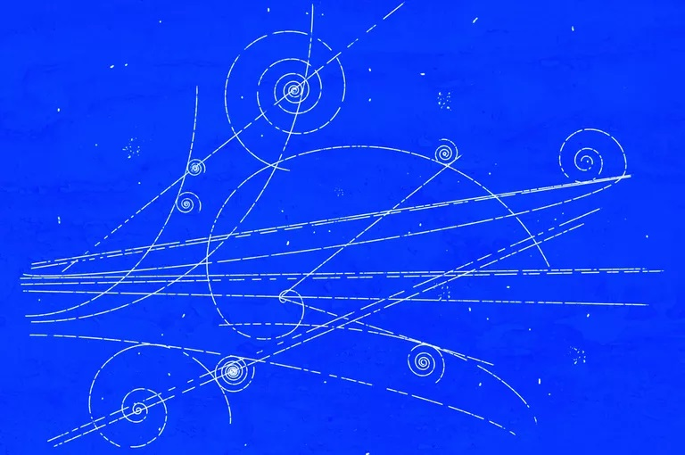
Bubble chamber track

Slide 6
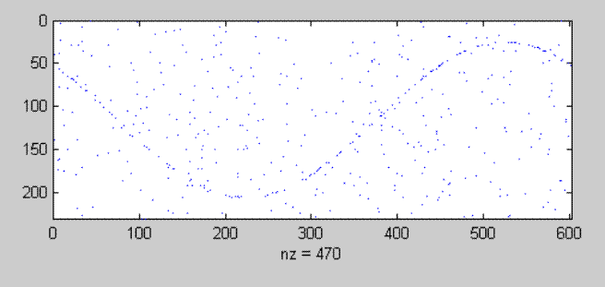
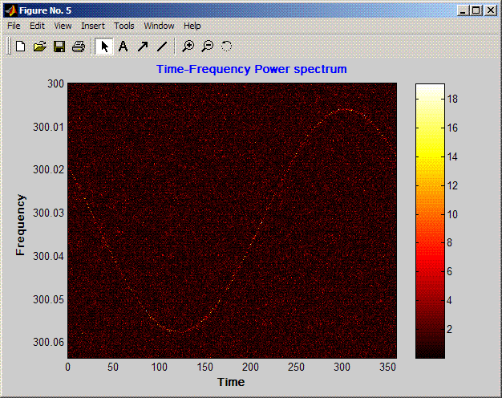
Time-frequency peak map and spectrogram
Frequency
Time

Slide 7
Why Hough
To use hierarchical method of search, the stack-slide method was proposed. It was in practice a form of the Radon transform.
The problem with this method was its sensitivity to spectral disturbances and its high computational cost. Hough transform considered only the presence of peaks over a given threshold, without taking into account the spectral amplitude (that is bigger in case of disturbances)
So, Hough transform has less numbers to crunch and uses bits instead of real numbers, giving gain in computing time of more than one order of magnitude. The “robustness” against spectral noise is due to the absence of the “bigness” of the disturbance peaks.
We later demonstrated that in ideal cases (absence of spectral disturbances), Radon was better. Later on, we developed a method that managed to achieve Radon's efficiency with a small computational overload (the Radon after Hough method).

Slide 8
Rome and Potsdam agreement
In the summer of 1997 Pia went to Potsdam to visit Maria Alessandra.
Then we initiated our collaboration. The first meeting was in Paris, at the GWDAW (November 1997), were we presented some ideas on the periodic source search (Papa, Astone, Frasca, Schutz “Searching for continuous waves by line identification”.
Many other meetings and discussions followed. The first public presentation of the Hough method was in Pasadena, at the Second International LISA Symposium, in July 1998.
In 1999 we organized a few days seminar at the Computer Center of the Sapienza University. The people who participated were Pia, Cristiano, Sergio, Maria Alessandra, Alicia and Federico Massaioli, an expert of High Performance Computing.
Cristiano, Federico and Alicia met in Potsdam to work on the algorithm.

Slide 9
Developments
The original Hough transform was developed between the time-frequency space and the ecliptic longitude and latitude space. Two different techniques were developed: in Rome, the Hough space was the entire sky, while in Potsdam, the sky was divided into patches (which allowed for longer coherent pieces).
Then we introduced some improvements, like the “Adaptive Hough” and the “Radon after Hough”,
There was a problem using the sky Hough (especially the full sky Hough): the distortion of the Hough space that was used, created clusters of false candidate signals. To solve the problem, the group in Rome changed the Hough space by using the frequency-spindown space, introducing the so-called “frequency Hough”. This resolved the issue.

Slide 10
References
Frasca-La Posta “Search for monochromatic sources with the GEOGRAV gravitational-wave antenna” (Il Nuovo Cimento 14C 1991, p.235-250
«Search of Monochromatic gravitational waves using resonant detectors» P. Astone, S.Frasca, G.V.Pallottino, G.Pizzella in Proceedings of the 12 th Italian Conference on General Relativity and Gravitational Physics, Rome, September 1996
Papa, Astone, Frasca, Schutz “Searching for continuous waves by line identification”. In Proceedings of the Second Workshop on Gravitational Waves Data Analysis, November 1997
Cristiano Palomba, Pia Astone and Sergio Frasca, «Adaptive Hough transform for the search of periodic sources» Class. Quantum Grav. 22 (2005) S1255–S1264
For the use of stereographic projection, the idea came from S.Frasca «Analogical Device for a Rough Localization of Gravitational-Wave Sources», Il Nuovo Cimento VOL. 3 C, N. 3, May-June 1980, were this projection was used for the «astrolabe»

Slide 11
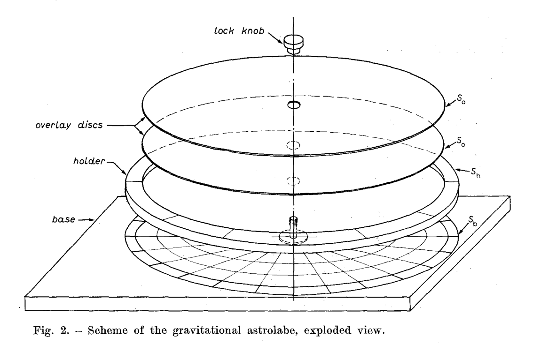
The gravitational Astrolabe

