Slide 1
Modelling continuous gravitational waves from neutron stars
Ian Jones
University of Southampton
@MPI for Gravitational Physics,
Hannover, 17th June 2024

Slide 2
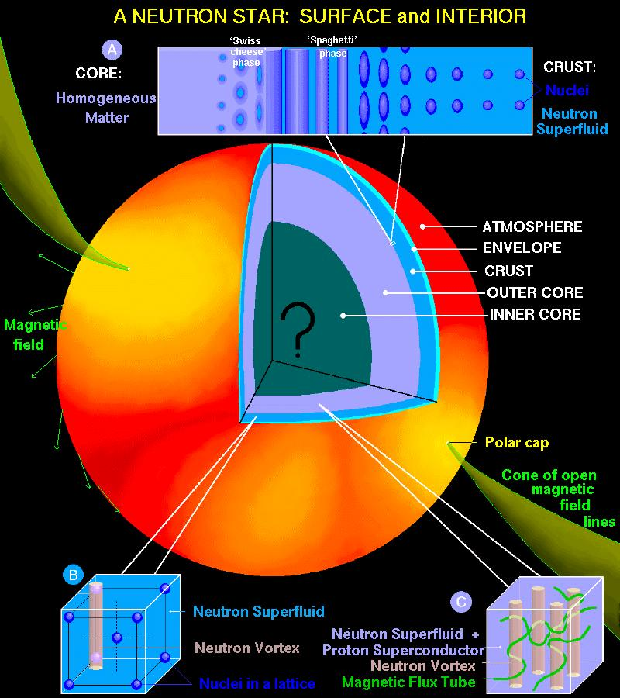
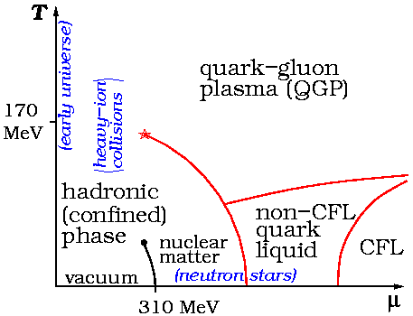
Neutron stars probe QCD

Slide 3
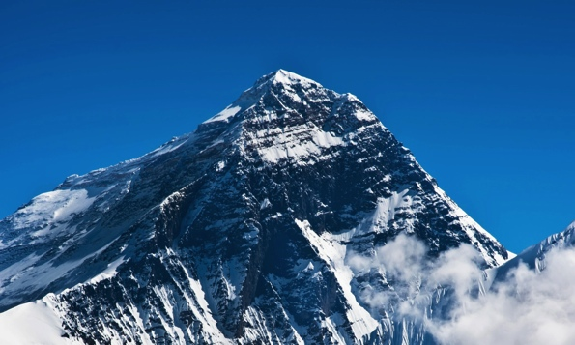
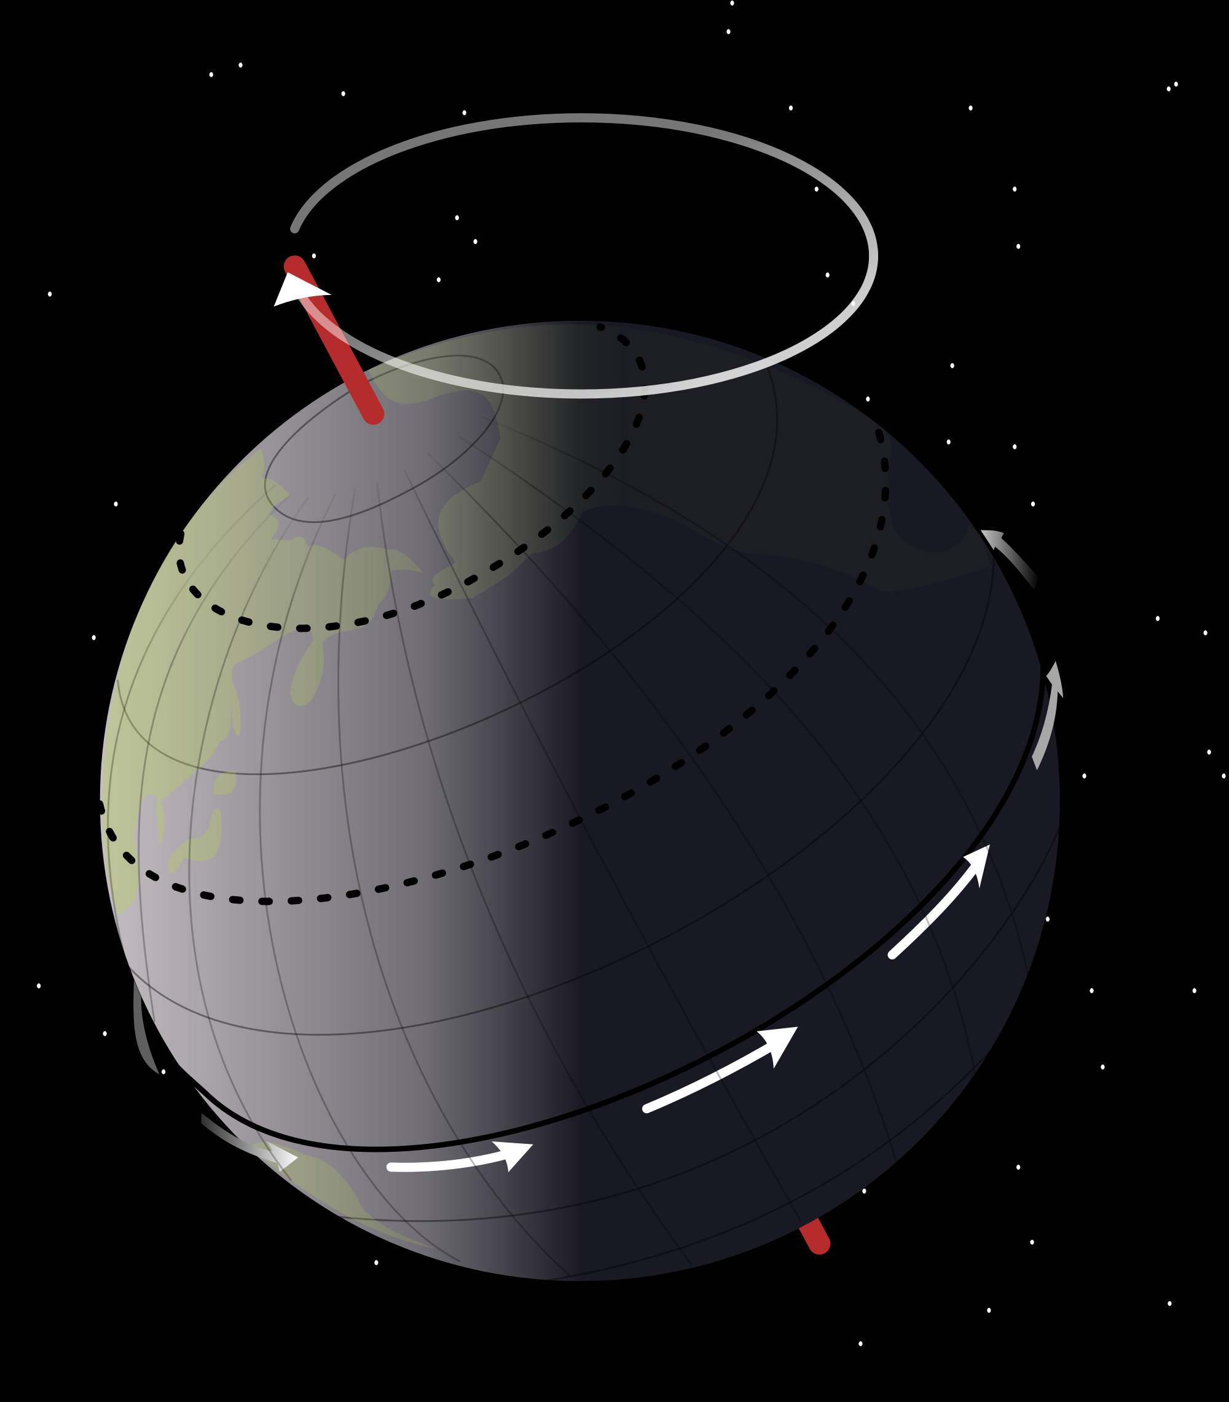
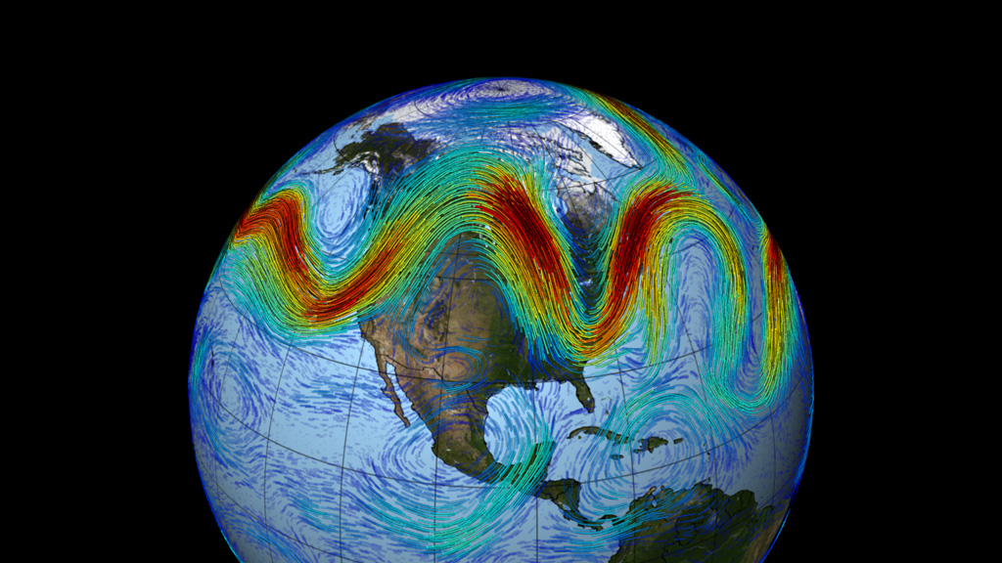
GW emission mechanisms for neutron stars
“Mountains” – non-axisymmetric deformation
“Wobble” - free precession
Most general motion of rigid body
Fluid oscillations – many possible sorts.

Slide 4
CGWs from neutron stars
Mountains
Oscillation modes
Elastic mountains
Magnetic mountains
Impulsive excitation
Instabilities
Maximum sizes
Likely sizes
Where active
Limiting size
The Inverse Problem: What Do We Learn?

Slide 5
Geophysics is a useful guide
Phenomenon | Earth | Neutron Star
Deformed shape | ✔ | Not yet observed
Quakes | ✔ Earthquakes | ✔(but more complicated)
Oscillations | ✔ Mainly elasto-gravitational | ✔ (can be elasto-magneto-gravitational)
Rossby waves | ✔ | Not yet observed
Free precession | (“Chandler wobble”) | May have been observed

Slide 6
Elastic Mountains

Slide 7
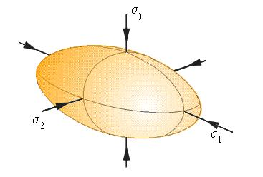
Gravitational waves from mountains
A triaxial neutron star, rotating steadily, emits gravitational waves:
Spin
frequency
Distance to
source
Dimensionless asymmetry
in moment of inertia tensor
Notes:
For Earth, epsilon approx 2 x 10^(-5).

Slide 8
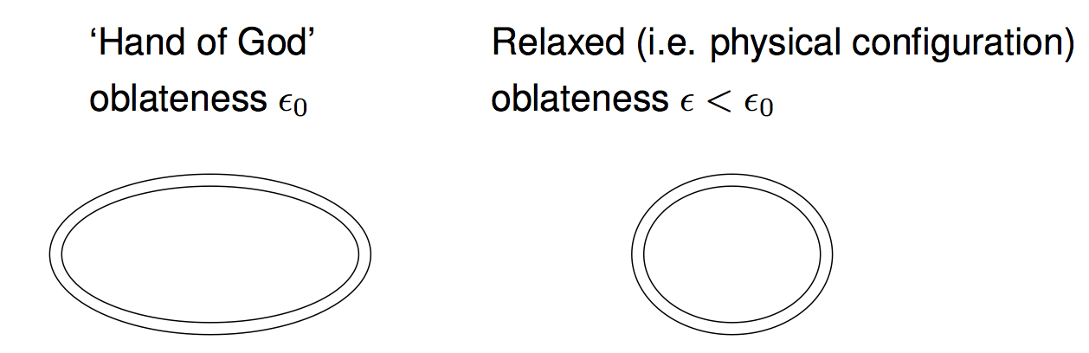



Elastic mountains: maximum
Energy of equilibrium star: $E=A ε^{2}+B {(ε_{0} − ε)}^{2}$
$A \sim$grav. binding energy $\sim \frac{G M^{2}}{R}$
$B \sim$elastic binding energy $\sim \int_{V}{μ dV}$
Minimise $E$ w.r.t. $ε$ at fixed $ε_{0}$: ${\left.\frac{∂E}{∂ε}\right|}_{ε_{0}}=0 ⇒$ $ε= \frac{B}{A+B} ε_{0}$

Slide 9


Elastic mountains: maximum cont…
For realistic NS, $B≪A$, $ε \sim {10}^{−5} ε_{0}$
Strain in crust $\sim \left|ε_{0} −ε \right|≈ε_{0}$
For a maximum breaking strain $u_{break}$:
$ε_{max}= \frac{B}{A+B} u_{break}= {10}^{−6} \left(\frac{B/A}{{10}^{−5}}\right) \left(\frac{u_{max}}{0.1}\right)$
$ε_{max}$ could be ${\sim 10}^{−4}$ for exotic QCD phases; see e.g. Owen (2005)

Slide 10
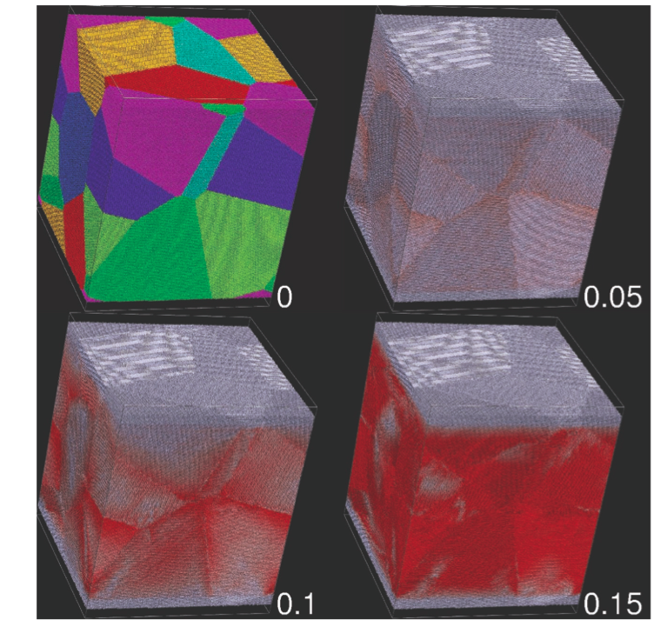
Elastic mountains: maximum cont …
Molecular dynamics of Horowitz & Kadau (2009) indicate high breaking strain.
Plastic flow may relax crust on longer timescales (Chugunov & Horowitz 2010)

Slide 11
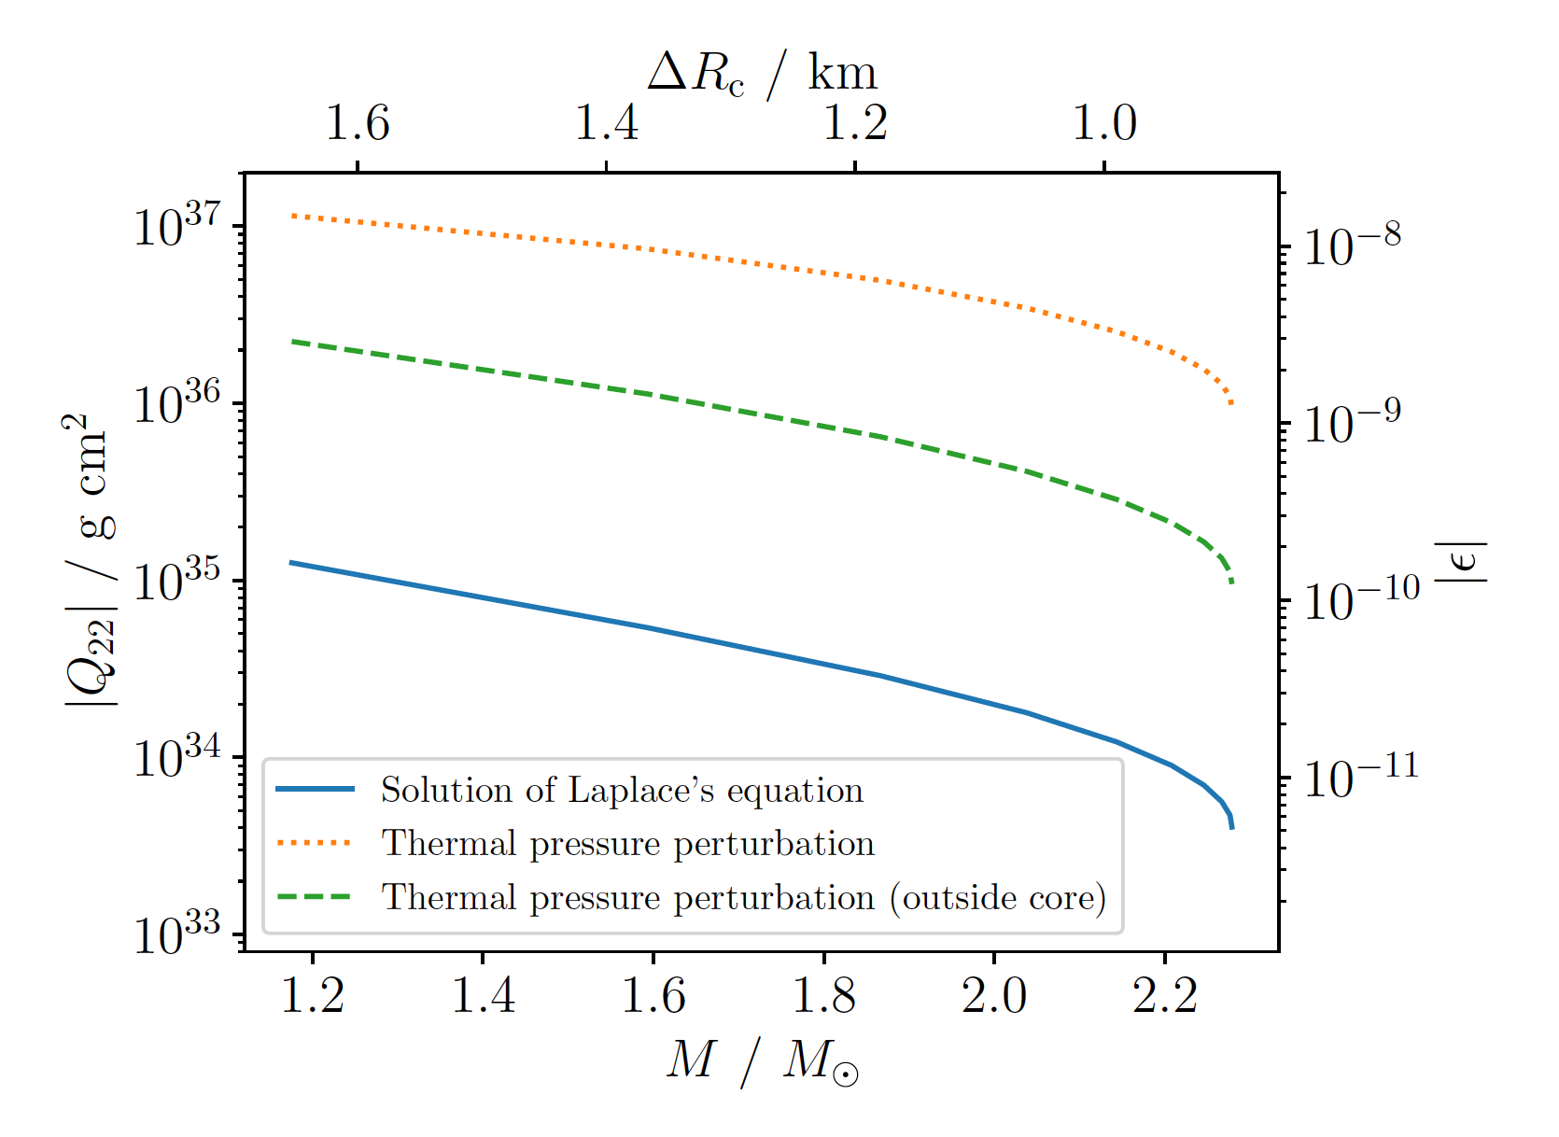
Elastic mountains: numerical calculations
Accuracy of rough estimate verified by numerical calculations of Ushomirsky, Cutler & Bildsten (2000).
Several follow up calculations since, using different set-ups and making different assumptions.
E.g. Gittins, Andersson & DIJ (2021), Gittins & Andersson (2021):

Slide 12
Realistic mountain sizes…
…or, how to you build a mountain on a neutron star?

Slide 13
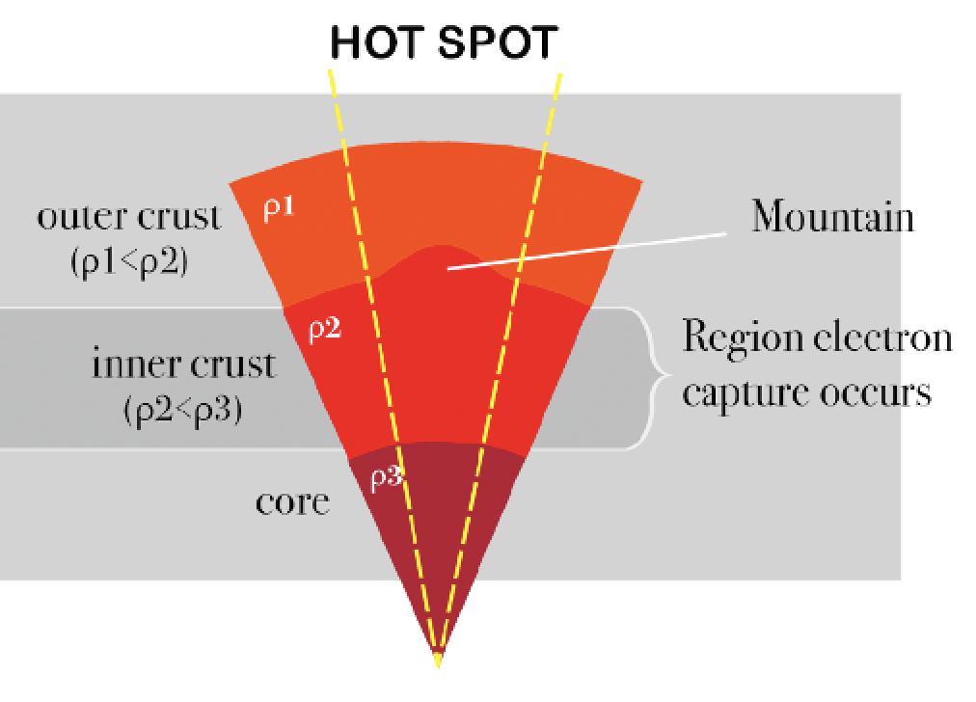
“Thermoelastic” mountains
Bildsten (1998) proposed building mountain via temperature/composition asymmetry in accreting stars.
Figure credit: Emma Osborne (2020)
Viability of mechanism confirmed by Ushomirsky, Cutler & Bildsten (2000).
Possible evidence for mechanism at work proposed (Haskell & Patruno 2017).
But key unknown is likely level of temperature asymmetry. Need ~ 1% variation…

Slide 14
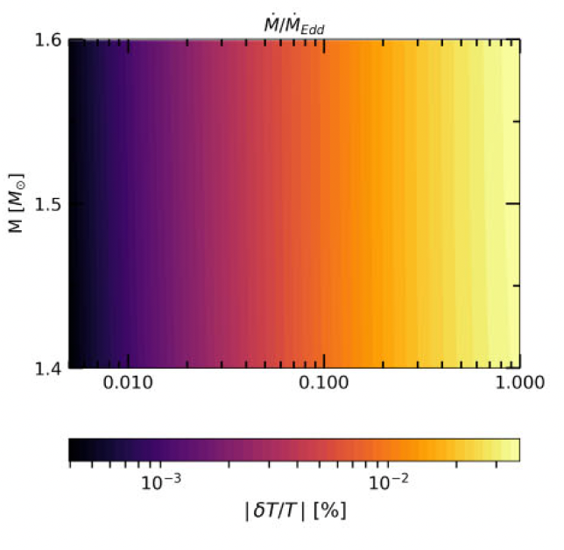
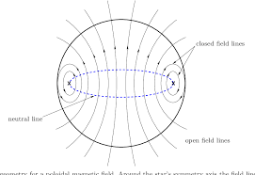

“Magneto- thermoelastic” mountains
See Osborne & DIJ (2020) and Hutchins & DIJ (2023) for concrete proposal: anisotropic heat conduction in magnetic field.
Hutchins & DIJ (2023); $B_{tor}= {10}^{8}$ G
Would need very strong internal toroidal fields for this mechanism to work.

Slide 15
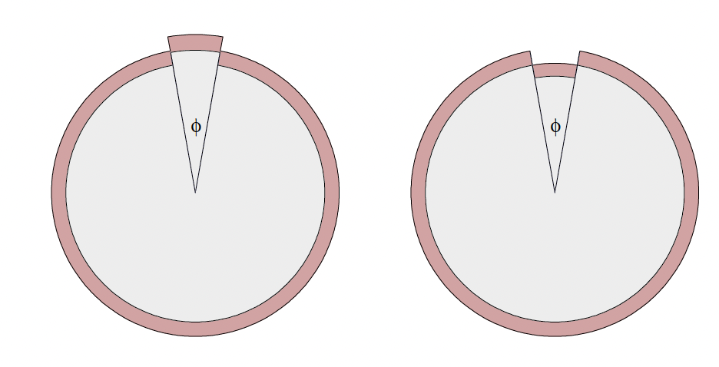
Mountains from crustquakes
Fattoyev & Horowitz (2018) suggested mountains may form in crustquakes
Particular example of this examined in Giliberti & Cambiotti (2022)

Slide 16
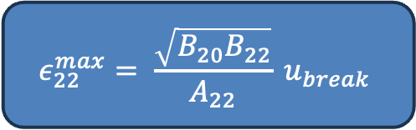
Mountains from crustquakes cont …
Gangwar & DIJ (2024) used energy model to model mountain formation in crustquake in spinning up star:
$$E=\frac{J^{2}}{2 I_{s} \left(1+ ε_{20}\right) } + A_{20}{ε_{20}}^{2}+B_{20} {(ε_{20,0} −ε_{20} )}^{2} + A_{22} ε^{2}+B_{22} {(ε_{22,0} −ε_{22} )}^{2}$$
Kinetic energy
Axisymmetric piece
“Mountain” piece
Can allow zero strain shape to change while conserving energy and angular momentum.
Found largest mountain you can build is
$$ε_{22}^{max}= \frac{\sqrt{B_{20}B_{22}}}{A_{22}} u_{break}$$

Slide 17
Magnetic Mountains

Slide 18
Magnetic mountains: back-of-the-envelope
Magnetic field lines have an effective tension, and deform star.
Not very big for typical pulsar magnetic field strengths

Slide 19
Magnetic mountains: back-of-the-envelope
If protons form type II superconductor, magnetic field confined to fluxtubes.
Effect of this is to increase tension by a factor of H_{c}/B, where H_{c} ∼ 10¹⁵ G,
increasing ellipticity:
But even then, the GW emission
from known pulsars is not
detectable.
Can get stronger emission from local
field burial in accreting systems (Haskell
et al 2015).

Slide 20
“Exotic” magnetic mountains: detectability
If CFL or 2SC phases occur in neutron star cores, can get colour-magnetic
flux tubes (Iida & Baym 2002, Iida 2005, Alford & Sedrakian 2010).
This leads to flux tube tension ∼ 10³ larger than in protonic superconductivity
case. Glampedakis, DIJ & Samuelsson (2012) modelled this:

Slide 21
Fluid oscillations

Slide 22
Rossby waves
Class of oscillations connected with
rotation of a fluid ball.
Named after Carl-Gustaf Rossby,
who identified them in atmosphere
in 1939.
Also found in the Earth’s oceans.
Restoring force is the Coriolis force.

Slide 23
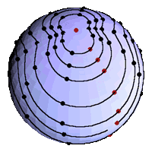
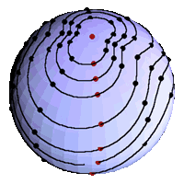
Instability: the CFS mechanism
GW emission can drive the r-mode unstable, a two-stream instability.
View from the inertial frame.
View from the corotating frame
Movie credit: Hanna & Owen

Slide 24
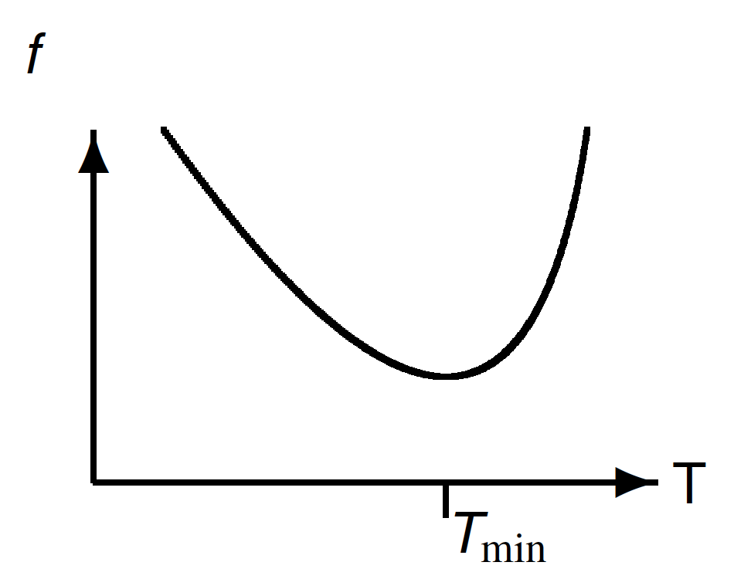
R-mode instability curve
Not all rotating fluid bodies are unstable…
… gravitational wave instability must compete with stabalizing effects of dissipation.
Dissipation rate temperature-dependent, giving rise to an instability window.
Active area of research: relating instability curve to stellar model.

Slide 25
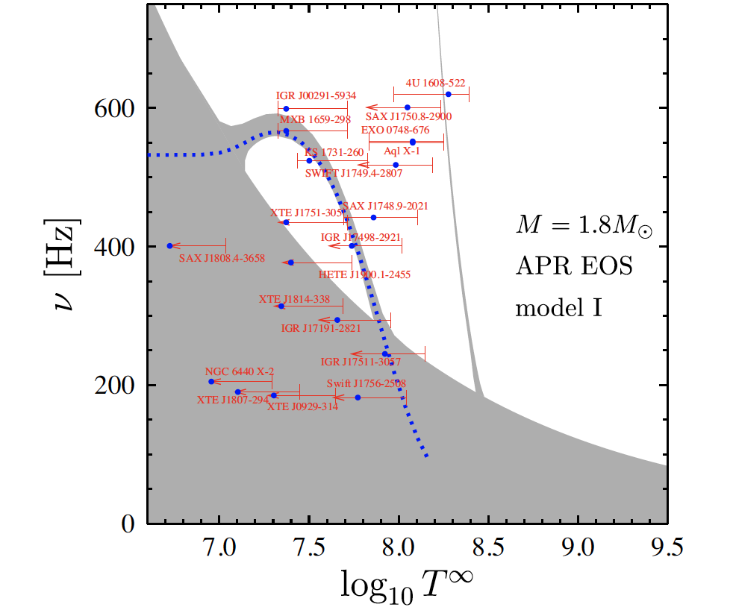
Realistic instability curves
Need to take many pieces of physics into account, including elastic crust, magnetic field, superfluidity, …
Large literature; see Glampedakis & Gualtieri (2018) review.
Example: Kantor+ (2020) consider “superfluid” modes, finding “stability spikes”:

Slide 26
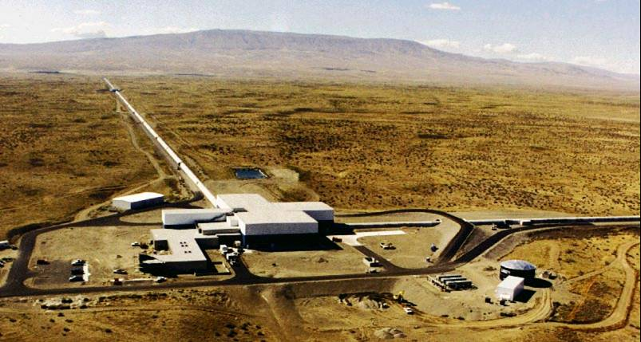
The inverse problem
Or, in the event of a detection, what do we actually learn?
???

Slide 27

Inverse problem
Ability to solve inverse problem depends in large part of what extra (i.e. EM)
Information is available.
If you only have GW signal, then harmonic content and frequency evolution
can be useful, e.g. braking index
$n ≡ \frac{f \ddot{f}}{{\dot{f}}^{2}}$
n=5 for mountains, n=7 for r-modes, but only if:
There are no non-CGW energy losses
The ellipticity/mode amplitude are constant
These are both strong assumptions!

Slide 28



Inverse problem
If $f_{GW} and f_{spin}$ measured separately, can use ratio:
for mountains
$$\frac{f_{GW}}{ f_{spin}} ≈$$
$\frac{4}{3}$ for r-modes
1 For small-angle free precession

Slide 29

Inverse problem: mountains
If only GW amplitude $h_{0}$ measured, get value of ${ε I}/d$.
If CGW signal is pure $n=5$ mountain, observed frequency evolution only partially breaks the degeneracy; can then measure the quantities
$\frac{\sqrt{I}}{d}$ or $ε^{2} I$ or $ε d$
Need a measurement of $d$ or use of theoretical estimate of $I$ to completely break the degeneracy. CGWs are “not quite standard sirens” (Sienikawska & DIJ, 2022)
BUT, there is no obvious way to distinguish between elastic and magnetic mountains
This is a BIG problem

Slide 30
Inverse problem: mountains
To distinguish between elastic and magnetic mountains, could maybe rely on
“circumstantial evidence”, e.g.
reject magnetic case if inferred ratio of internal/external magnetic
field strength too far from unity?
Look at relative phasing of CGW and EM (e.g. radio pulsar) emission?
See Lu+ (2023) and Hua+ (2024) for more on inverse problem.

Slide 31


Inverse problem: r-modes
If $f_{GW}$ and $f_{spin}$ both measured, departure from 4/3 gives information on mass and radius, which directly connects with the high density equation of state.
Caride+ (2019) give fitting formula (see also Ghost+ (2023)):
$\frac{f_{GW}}{f_{spin}} ≈ A − B {\left(\frac{f_{spin}}{f_{spin, K}}\right)}^{2}$
A= 4/3 in Newtonian limit.
Depends mainly upon
compactness M/R
Rotational correction.
Depends mainly upon
Average density M/$R^{3}$
Adding in other bits of physics (e.g. resonance with crustal oscillations)
can spoilt this.

Slide 32
Inverse problem: r-modes cont …
If temperature can be measured and/or estimated, can also map out
the instability curve.
This places an upper limit on the sum of all dissipative process that damp the r-mode.

Slide 33
Summary
LIGO-Virgo observations beginning to probe regimes of astrophysical interest, but detection likely requires:
  Elastic mountains close to maximally strained, or…
  ... elastic mountains from exotic phases, or …
  … exotic magnetic field configuration, or …
  … excitation of oscillation mode, probably via instability.
Not clear when first detections will be made.
Inverse problem severely hampered by DEGENERACIES.
Notes:
Thin this out?

