Slide 1
Detection of unmodeled CWs using a Transfer Learning approach
Diego S. Dominguez*, Seiya Sasaoka, Kentaro Somiya and Hirotaka Takahashi G.
Continuous gravitational waves and neutron stars workshop
Somiya Lab.
Hannover, Jun 20th 2024

Slide 2
Today’s Outline
Introduction…………….………………………………………………….……..……………….2
Motivation and objectives……..................................................................3
Deep Learning basics……………………………….………………………………………….4
Transfer Learning…….……………………………….………………………………………….5
ResNeXt50……………………………….………………………………………………………….6
Input Data…………………………….……………………………………………………………..7
Network architecture……………………………….………………………………………….8
Training and Validation…....…………….………………………….………………………..9
Performance…………………………………………………….………………………..…..…10
Detection efficiency – Targeted search.…………………………………..…………11
Summary….…………………………………………………………………………….…………12

Slide 3
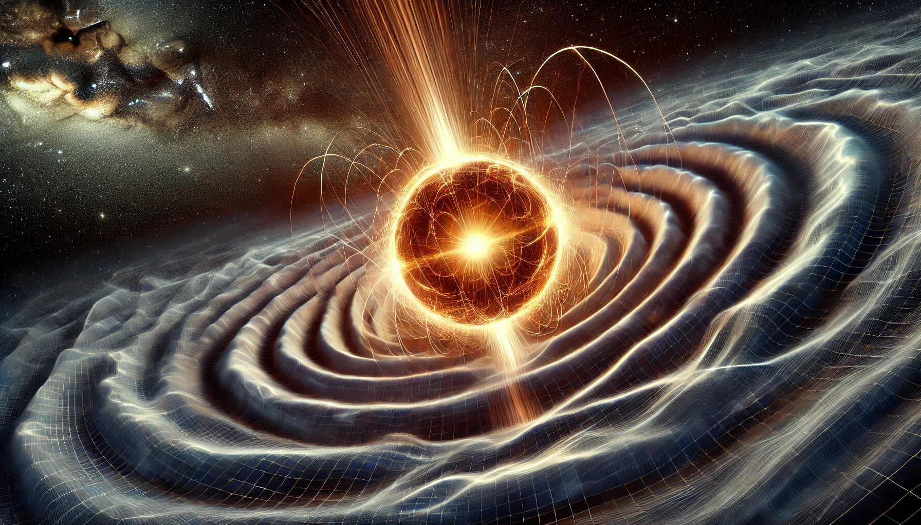
Introduction
Non-axisymmetric neutron stars are expected to emit quasi-monochromatic long-standing continuous waves (CWs).
Detection of CWs may give valuable insight into open questions about the population of neutron stars and their internal structure.
Both coherent and semicoherent methods have their limitations.
It would be nice to have a quick look-up tool !
Enter Deep Learning. By using significantly less computational cost, in some applications it has proven to rival matched-filtering sensitivity.
Fig 1. DALL E3’s impression of a rotating neutron star

Slide 4
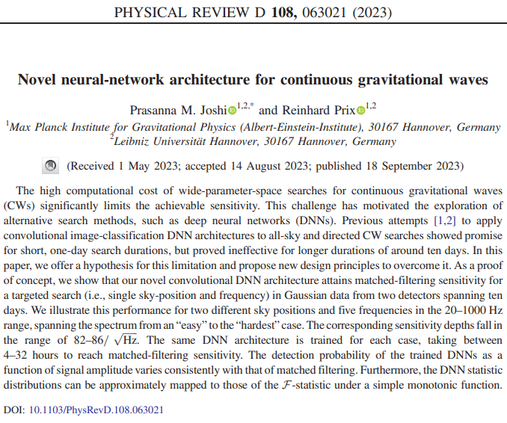
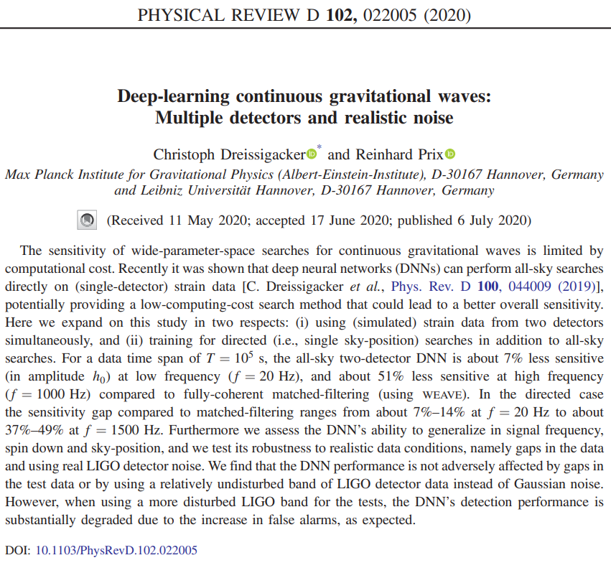
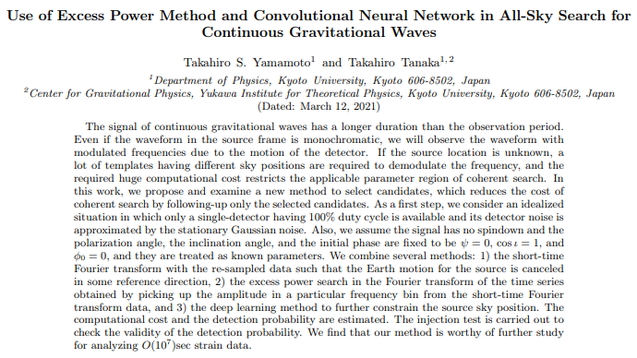
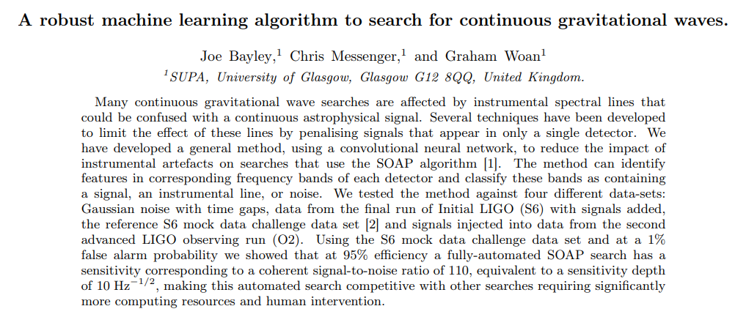
Motivation and objectives
GOAL: Development of a binary classifier to detect CW signals using a Transfer Learning approach
Instead of development from scratch, we start with a pretrained state-of-the-art CNN (ResNeXt-50)
Train models (Gauss ResNeXt and O3 ResNeXt) to detect CW signals in both Gaussian and real detector noise
Evaluate the generalization capability of the model
WHY?: Need for quick detection techniques for CW signals using ML.

Slide 5
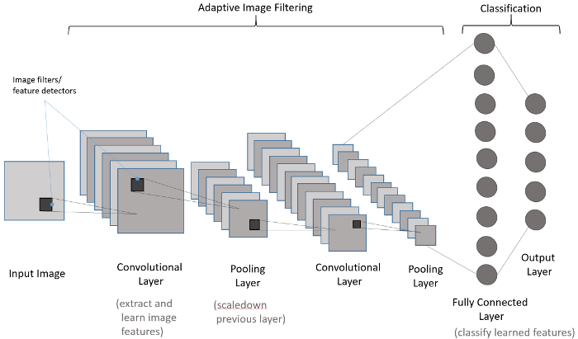
Deep Learning basics
Parameters update (Gradient descent)
Actual label $y′$
Random initialization of parameters
Loss function $L\left(y,y^{′}\right)$
Predicted label $y$
Feed forward
1 epoch/iteration

Slide 6
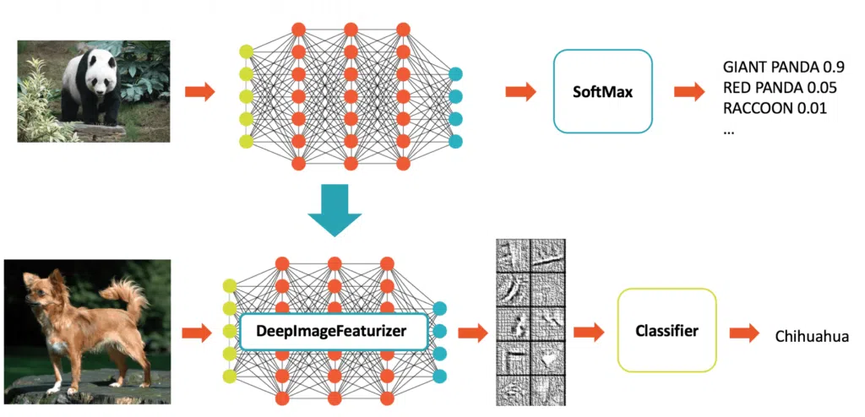
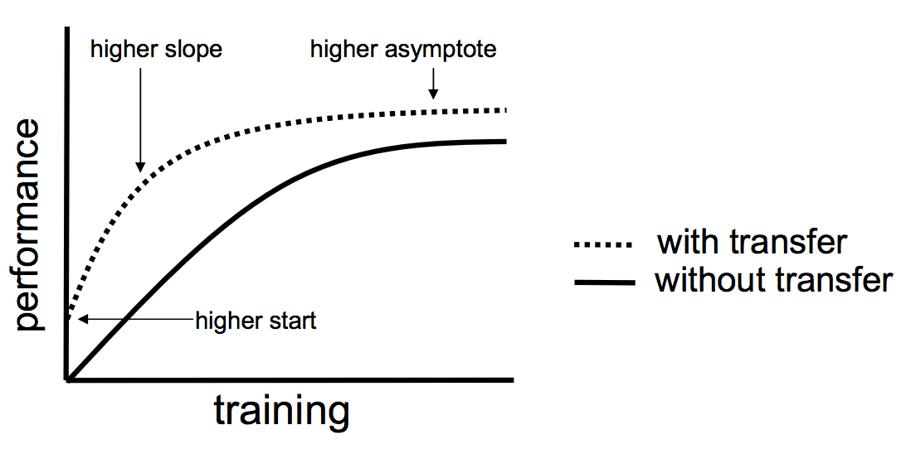
Transfer Learning
We train a base network on a base dataset and task, and then we repurpose the learned features, or transfer them, to a second target network to be trained on a target dataset and task.
We don’t start with randomly initialized parameters
It saves time and achieves higher accuracy from epoch 1

Slide 7
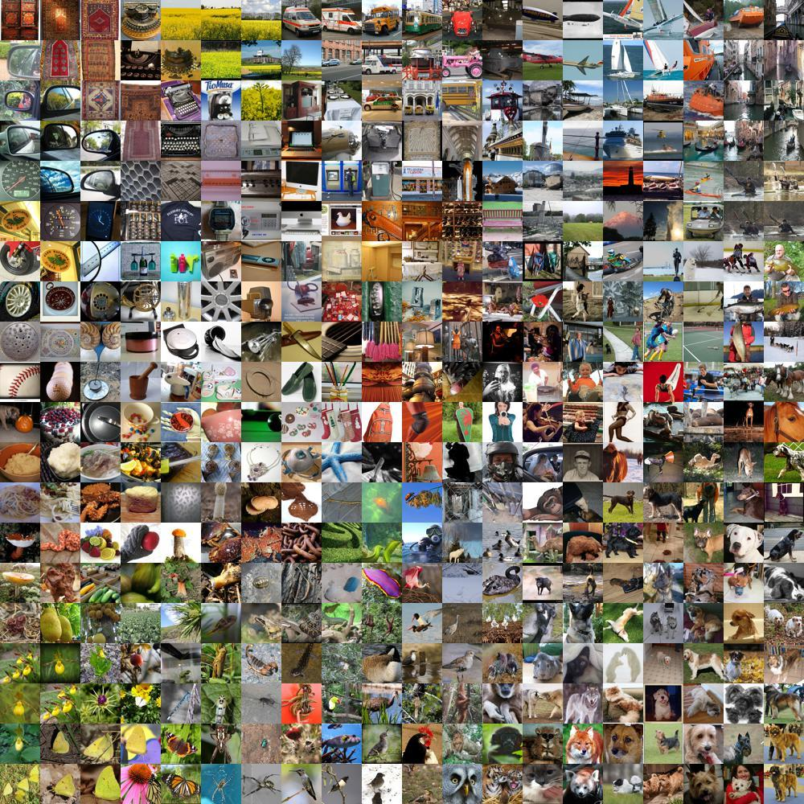
ResNext50
Why not leverage the knowledge of a massive pre-trained state of the art CNN ?
i.e. Inception, ResNet, EfficientNet
We chose ResNeXt50 (updated version of ResNet)
It has residual blocks that preserve information between layers
25 million tunable parameters
1000 classes including:
Goldfish
Triceratops
Cats
Dogs
Go-karts
Furniture
$$⋮$$
ImageNet1K
Dataset

Slide 8
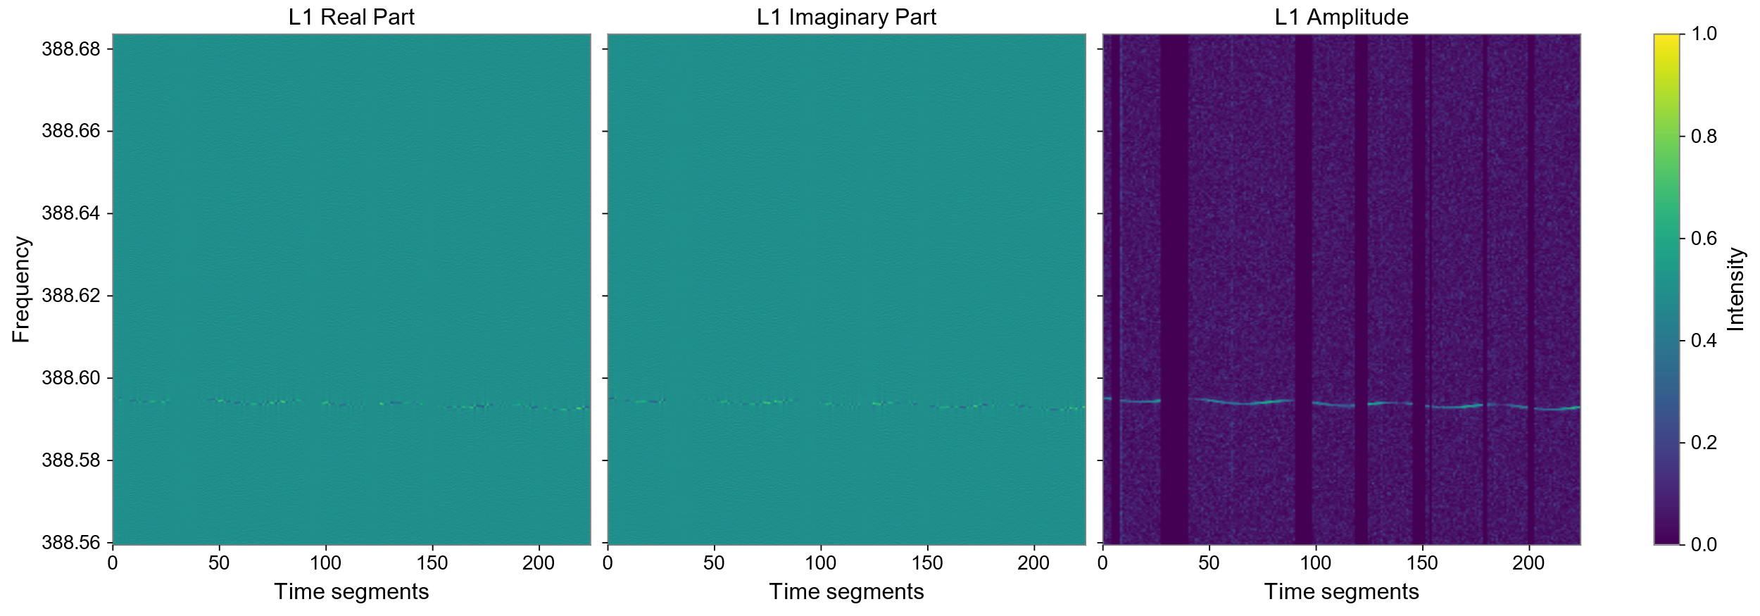
Input data
Time frequency representation (Complex spectrogram)
SFT length = 30 min
Gaussian noise data (Gauss ResNeXt)
Two detector simulated gaussian noise with realistic time gaps
Standard ResNeXt-50 input:
3 channels, each 224 px $×$ 224 px
Real detector data (O3 ResNeXt)
Observation run O3 data from H1 and L1
Parameters prior distributions
224 frequency bins
$$224×\frac{1}{1800} Hz∼124 mHz$$
224 SFT (each 30 mins)
$$224×30 min∼4.66 days$$
We adopted Curriculum learning, network’s SNR is the difficulty criterion
224
$$⋯$$
$$SNR=500$$
$$SNR=460$$
$$SNR=40$$
224
$∼3×{10}^{4}$ samples

Slide 9
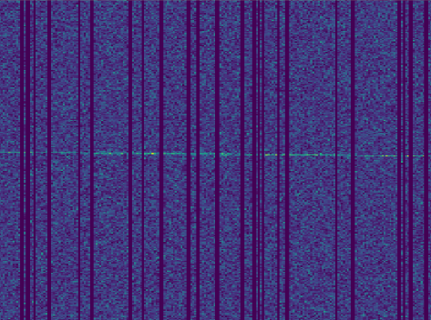
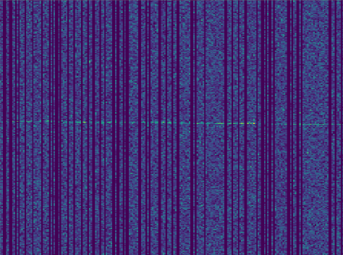
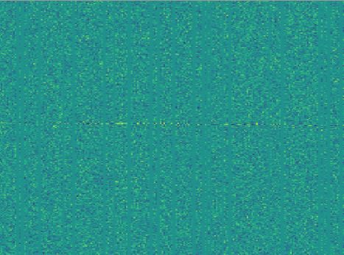
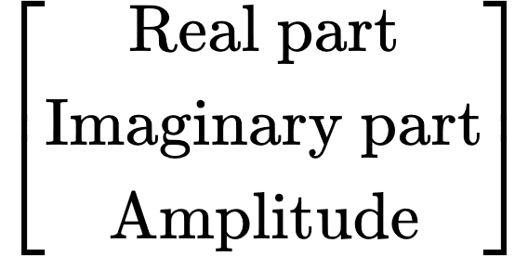
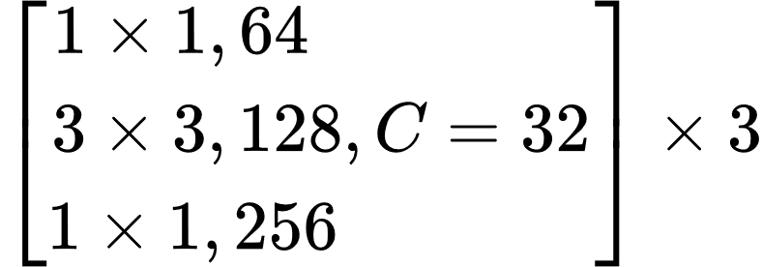
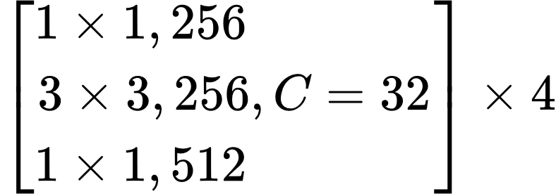
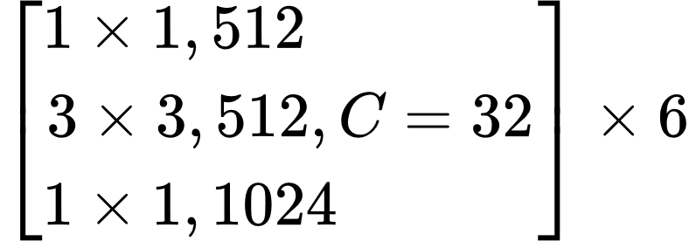
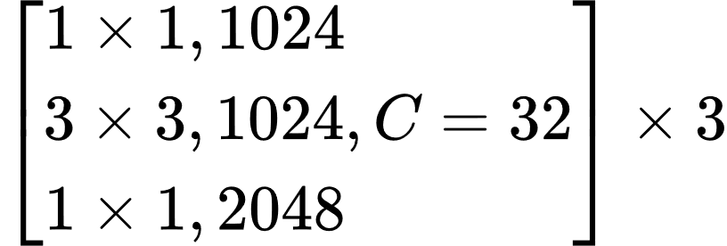
Network architecture
Conventional CNN architecture lose information
Down sampling
Feature transf. across layers
Frozen parameters
Residual connections prevent this!
Identity mapping of the input to deeper layers.
This is a key feature of the ResNeXt architecture
Linear(4,64)
BN, Drop-out
Linear(64,32)
BN
Linear(32,2)
Sigmoid
25 million trainable parameters
∼500.000 trainable parameters
∼6 million total trainable parameters

Slide 10
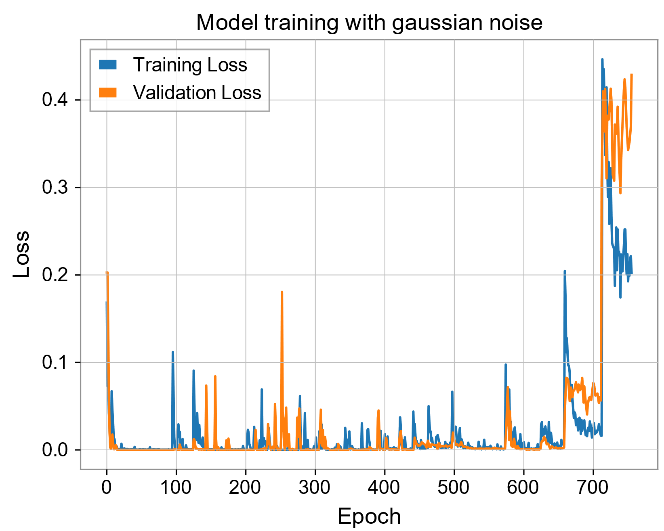
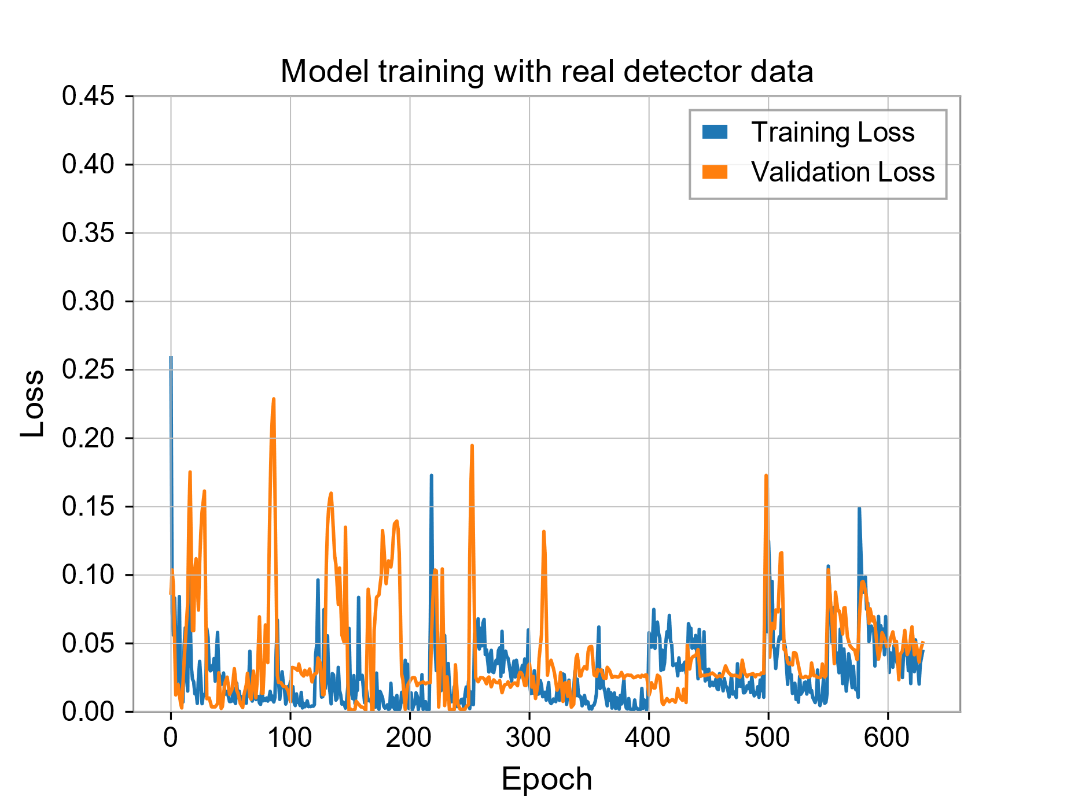
Training and validation
True label
To ensure effective training:
Hyperparameter tuning with Optuna
L2 regularization with $λ={10}^{−5}$
Early stopping
Loss function: cross entropy
Model’s prediction
Training time $∼20.3$ hours
Software and Hardware: Pytorch 2.0 implementation / 16 GB NVIDIA TESLA V-100 GPU

Slide 11
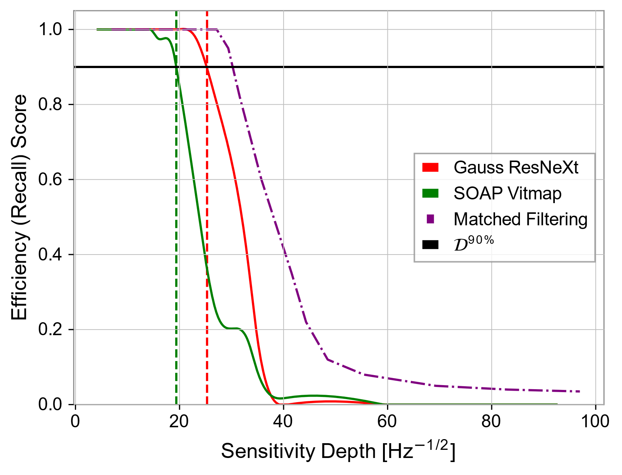
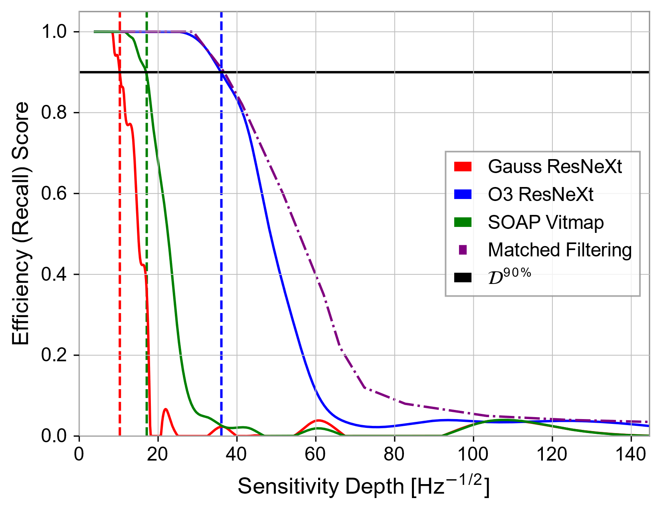
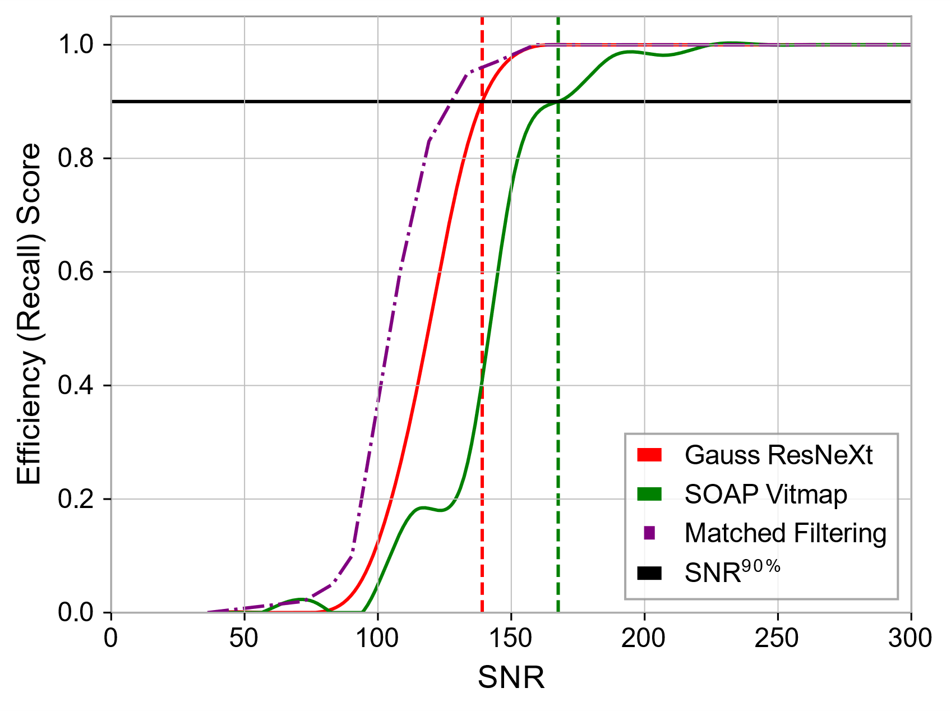
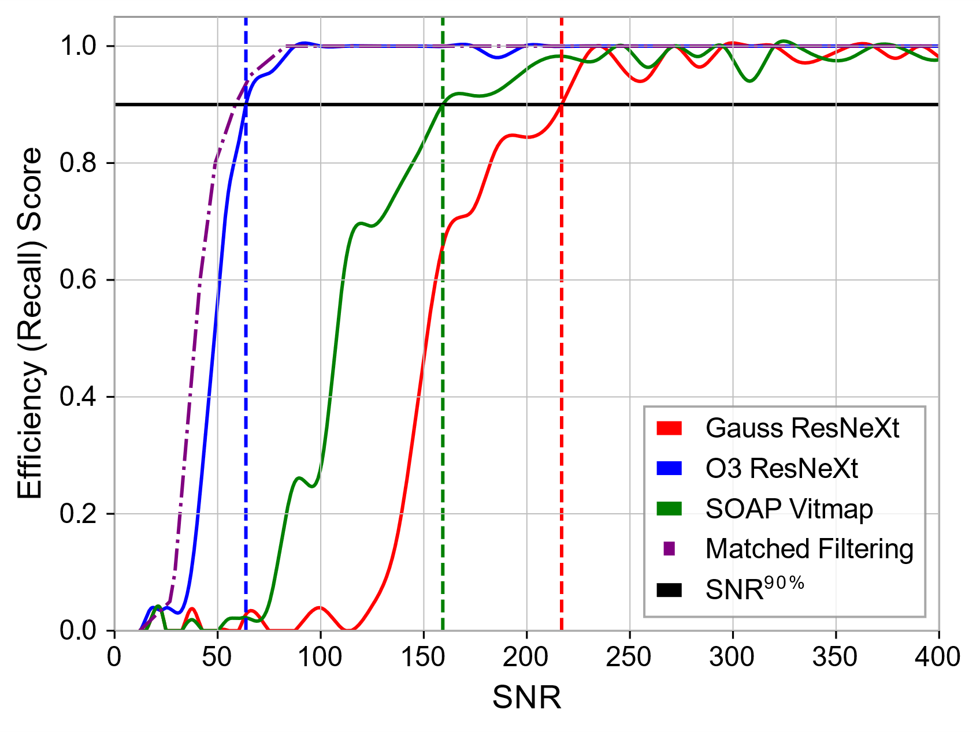
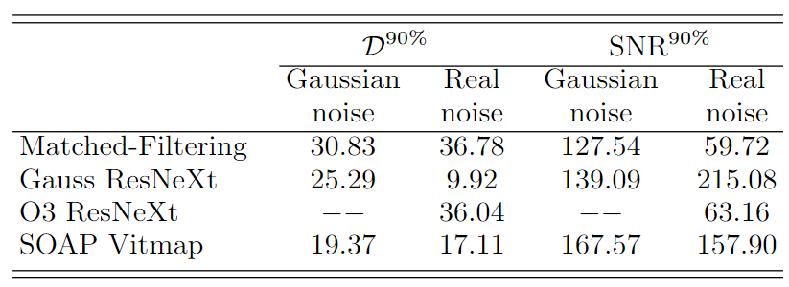
Performance
Gaussian Noise
Real detector noise
We compared Gauss ResNeXt and O3 ResNeXt against the SOAP CW¹ pipeline (vitmap) and Matched-Filtering (WEAVE)
Our two metrics are the SNR and sensitivity depth (at a $p_{fa}=1\%$) for which we attain a 90% efficiency of detection
[1] J. Bayley et al, Phys. Rev. D. 102 083024 (2020)

Slide 12
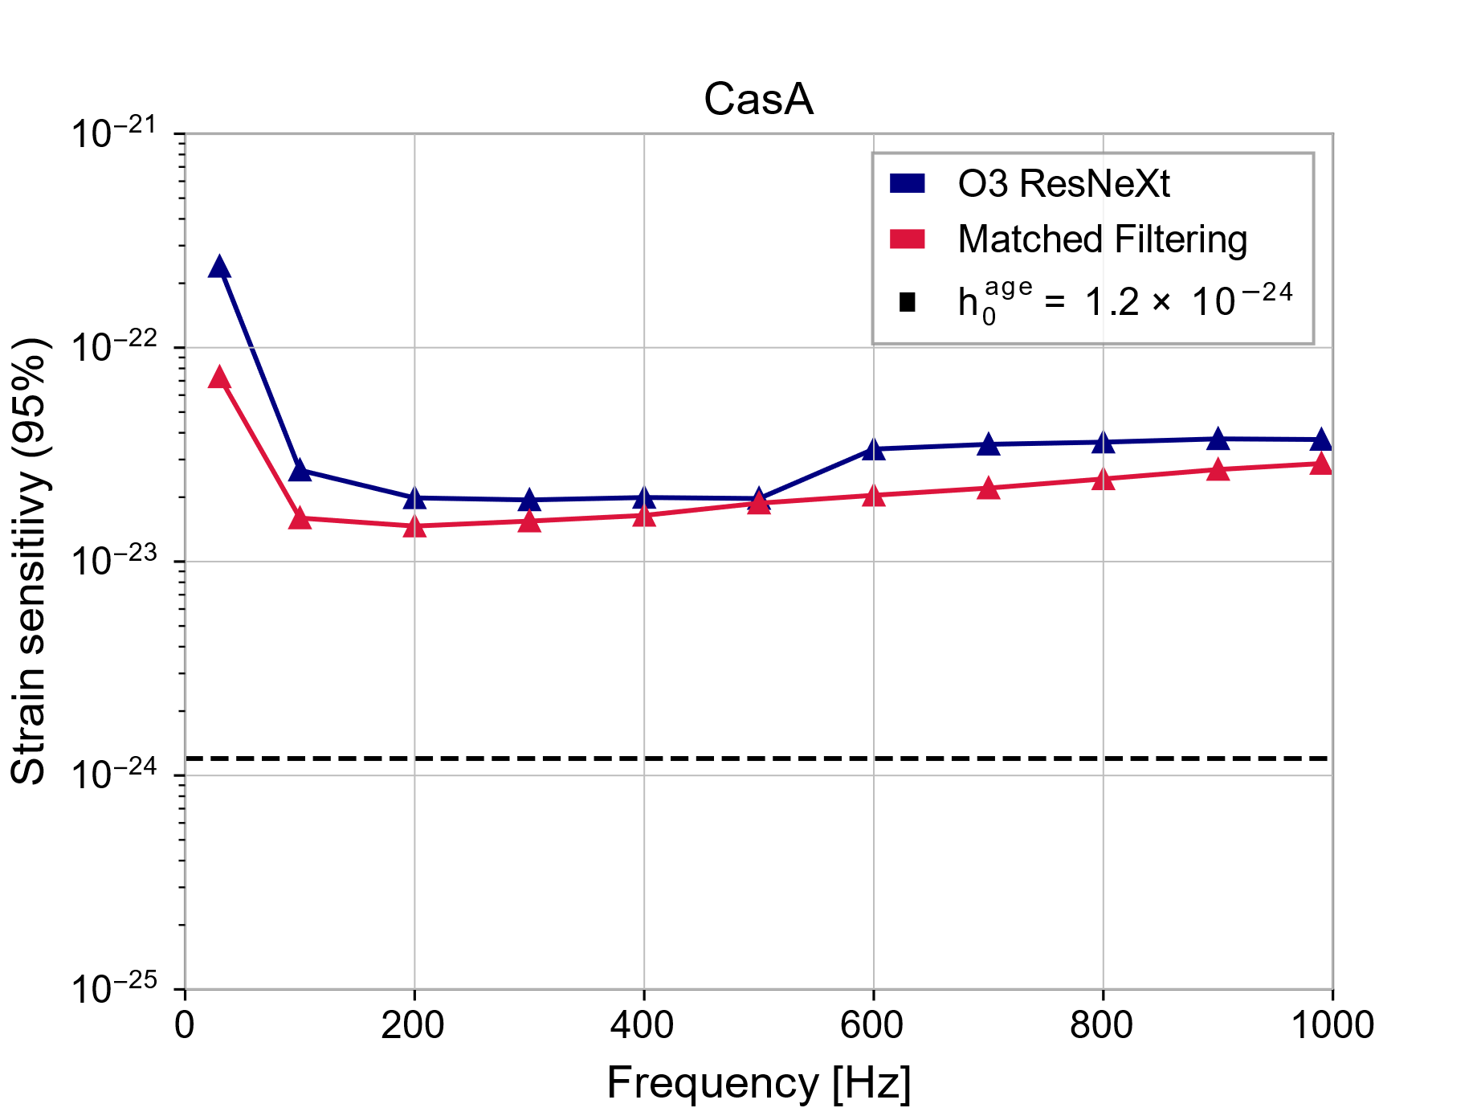
Detection Efficiency – Targeted search
As a test benchmark, we compare O3 ResNeXt performance against matched filtering for the Cas A remnant with a strain age $h_{0}∼{10}^{−24}$
Results comparable to matched-filtering

Slide 13
Summary
Transfer learning is a good alternative to train deeper models in less time
We developed binary classifier CNNs, Gauss ResNeXt and O3 ResNeXt, using transfer learning to detect continuous wave (CW) signals in Gaussian and real detector noise.
Both models achieved detection sensitivities close to matched-filtering for short observation periods (approximately 4.66 days).
Gauss ResNeXt and O3 ResNeXt showed strong detection capabilities in their respective noise environments but had poor generalization to other noise types.
Future Work: Generalization to longer spectrograms… Bayesian approach or even more DL!

