Slide 1
Fast optical photometry as a tool (for CW counterpart searches)
Riccardo La Placa
Giulia Illiano
Alessandro Papitto
Filippo Ambrosino
Arianna Miraval Zanon

Slide 2
SemiCoherent searches:
dove siamo
Breve introduzione ai nostri successi e fallimenti
Riccardo, Giulia, Filippo, Alessandro

Slide 3
Classical pulsar scenarios
Rotation-powered
Accretion-powered
Credit: Dana Berry NASA/GSFC SVS
Credit: Bill Saxton, NRAO/AUI/NSF

Slide 4
High-time resolution optical astronomy
Fast time variability probes geometry and emission mechanisms
Millisecond pulsars
Accreting neutron stars

Slide 5
Detectors for fast optical photometry
Instrument | Detector | Group | Time res [s] | Mode | Telescope
SiFAP2/4XP | SiPM | INAF Rome / FGG | 8E-11 | Timing/Polarimetry | 3.6m TNG
Aqueye+/Iqueye | SPAD | INAF Padua | 1E-10 | Fast timing | 1.8m Copernicus
HiPERCAM | CCD | Sheffield/IAC | 6E-03 | 5-band imaging | 10.4m GTC
ULTRACAM | CCD | Sheffield/Warwick | 5E-03 | 3-band imaging | 3.6m ESO NTT
ULTRASPEC | eMCCD | Sheffield/Warwick | 1E-03 | Spectroscopy | 2.4m ThaiNT
GASP | eMCCD | Galway | 6E-04 | Polarimetry | WHT (past)
Optima | APD | MPE | 1E-09 | Timing/Polarimetry | 1.3m Skinakas

Slide 6
The Silicon Fast Optical Photometer
Extremely fast photometer based on Silicon Photo-Multipliers (SiPMs)
Capable to tag single photons with a time resolution of 8 ns 80 ps
Absolute timing accuracy < 60 20 μs
Very good linearity with high count rates (up to 5 Mcps)
New polarimeter in the calibration phase!
[Meddi+ 2012; Ambrosino+ 2013, 2015; Ghedina+ 2018; Ghedina+ 2022]

Slide 7
PSR J1023+0038
Count rate ~ 10000 c/s (V ≈ 16.5 mag)
Pulse amplitude ~ 1%
[The "transitional" comes from their being observed in both accretion-dominated and rotation-dominated regimes, see e.g. Archibald+ 2009, Papitto+ 2013, Stappers+ 2014, Bassa+ 2014]

Slide 8
Pulsed flux density
[Papitto+ 2019]

Slide 9
Standard emission mechanisms hardly individually explain the observed optical pulsed luminosity
Rotation power
Optical efficiency:
[Ambrosino+ 2017]
Credit: Bill Saxton, NRAO/AUI/NSF

Slide 10
Standard emission mechanisms hardly individually explain the observed optical pulsed luminosity
Accretion power
Optical pulses due to cyclotron emission by infalling electrons in the accretion columns?
Credit: Dana Berry NASA/GSFC SVS
[Ambrosino+ 2017]

Slide 11
Very bright optical pulsations: accretion, spin power, or both?
A pulsar wind heating the accretion disk
Synchrotron radiation from the shock between the striped wind and the accretion disk
[Papitto+ 2019]
Different synchrotron timescales of optical and X-ray photons:
[Veledina+ 2019]

Slide 12
Time lags between optical and X-ray pulsations
[Papitto+ 2019]
[Illiano+ 2023a]

Slide 13
Millisecond pulsar timing in the optical band
Aqueye+ @ Asiago Observatory
[Burtovoi+ 2020]
Smoother orbital expansion
[see also Jaodand+ 2016, 2021; Zampieri+ 2019]
[Illiano+ 2023a, A&A, 669]

Slide 15
New outburst of SAX J1808 in August 2022
Multi-wavelength observational campaign
Goals:
Optical/UV pulse emission mechanism at different mass accretion rates along the outburst
Coherent X-ray timing and long-term spin and orbital evolution
NICER
NuSTAR
XMM-Newton
PI: Papitto
22 Aug.- 31 Oct.
Exp: > 180 ks
PI: Papitto
22-23 August
Exp: 120 ks
PI: Papitto
9-10 September
Exp: 120 ks
TNG/SiFAP2
HST/STIS
PI: Miraval Zanon
26-27 August
Exp: 4 hr
PI: Miraval Zanon
10 September
Exp: 2240 s
[Illiano+ 2023b]
[Miraval Zanon+, subm.]

Slide 16
PSR J1023+0038
SAX J1808.4-3658
X-ray Luminosity ( erg/s)
5
30-60
Optical Luminosity ( erg/s)
1
5
Optical rms amplitude
1%
0.5%
Optical/X-ray phase shift
0.1
0.5
UV Luminosity ( erg/s)
1.5
7.6
UV pulse amplitude
1%
2.6%
Do accretion and rotation power coexist?
Does accretion produce optical pulsations much brighter than expected?

Slide 18
Searching for pulsations from the brightest accreting NSs
Only 10% of accreting neutron stars show X-ray pulsations
Pulse sensitivity (A~0.01-0.05% in a hours from the brightest sources)
Detection would greatly enhance continuous GW (directed to targeted searches)

Slide 19
Searching for pulsations from the brightest accreting NSs
Only 10% of accreting neutron stars show X-ray pulsations
Pulse sensitivity (A~0.01-0.05% in a hours from the brightest sources)
Detection would greatly enhance continuous GW searches (collaboration with the LIGO/VIRGO CGWs group)

Slide 20
Searching for pulsations from Scorpius X-1
Commensal science!

Slide 21
Searching for pulsations from Scorpius X-1
Simple searches

Slide 22
Searching for pulsations from Scorpius X-1
Accelerated searches

Slide 23
Searching for pulsations from Scorpius X-1
Simple PS, no orbital correction
Accelerated searches

Slide 24
Searching for pulsations from Scorpius X-1
Simple PS, no orbital correction
Accelerated searches
Blind searches
No parameters known a priori (or large uncertainties)
At least 4 parameters (f_{spin} , P_{orb} , a sin(i) , t_{asc} )
$$a\sin{(i)}$$

Slide 25
Semi-coherently searching for pulsations from Sco X-1
T
span
Split T_{span}-long interval in M segments
Coherent analyses on each segment
Statistics summed incoherently
T
seg
Already carried out in the X-ray band, but to no avail
[Messenger&Patruno 2015, Patruno+ 2019, Galaudage+ 2022]
Why do it?
(and always think of your number of trials…)

Slide 26
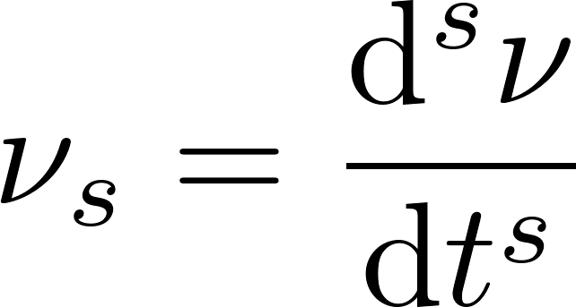
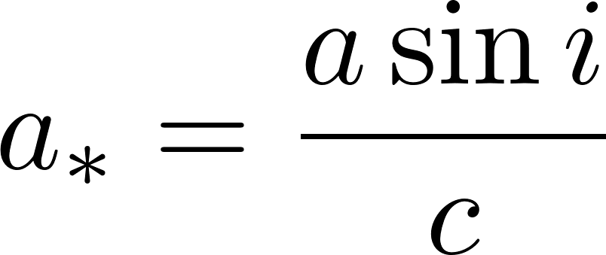
Semi-coherently searching for pulsations from Sco X-1
Following Messenger [2011], Leaci & Prix [2015], we further split into:
A semi-coherent space
A coherent space
Generally much smaller!

Slide 27
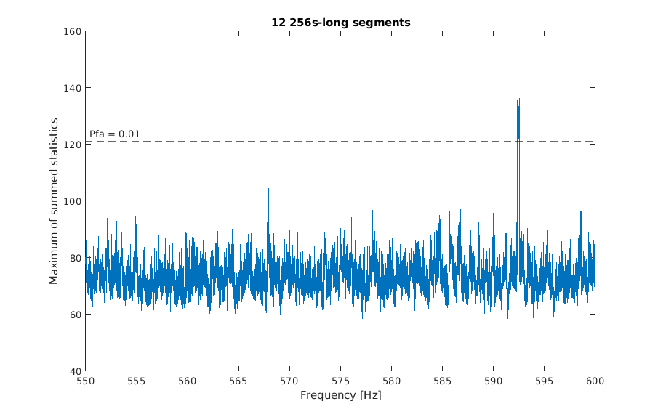
(All in Matlab …for now at least)
Semi-coherently searching for pulsations
J1023
Coherent temp. bank through extrema of possible values and density given by min. shift
For each segment and eachν combination
Obtain corrected ToA through
Resample from t to τ and simply forward FFT (no RoI selected)
What about Sco X-1?
Take the respective Λ, sum it to the previous ones and move to the next segment
Search through the coherent space for NN given current parameters
For each physical parameters combination
Save your Λ, do it all again for the next frequency and derivatives combination

Slide 28
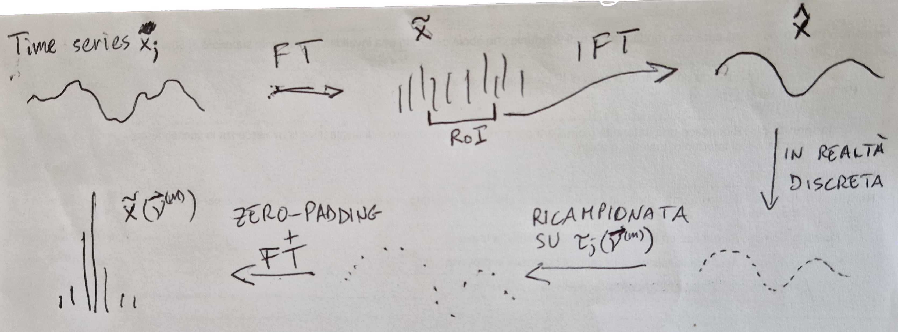
Semi-coherently searching for pulsations from Sco X-1

Slide 29
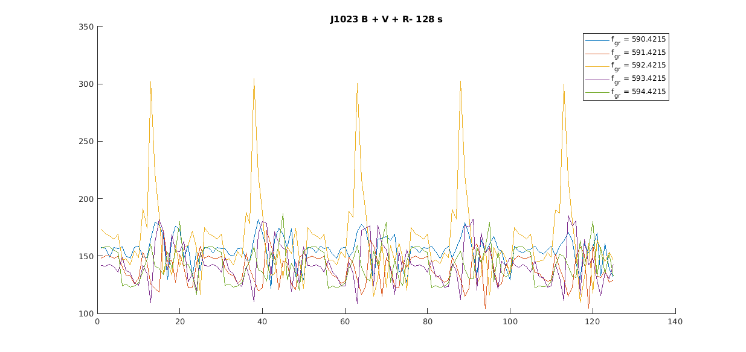
Semi-coherently searching for pulsations from Sco X-1
After doing that for all segments, back to physical parameters:
Create large template bank in (f_{spin} , P_{orb} , a sin(i) , t_{asc} )

Slide 30
Fast optical photometry for:
Optical millisecond pulsars
The transitional PSR J1023+0038
The accreting SAX J1808.4-3658
Accretion vs Rotation power (or both?)
Optical pulsations from bright low-mass X-ray binaries
Sco X-1 and other candidate sources for continuous GW searches
Large collection of archival data (searches underway, one particularly interesting source…)
And many more…
Magnetars, CCOs, repeating FRBs, etc.

Slide 31
Alessandro Papitto
Filippo Ambrosino
Arianna Miraval Zanon
Giulia Illiano
Feel free to look us up!
https://www.oa-roma.inaf.it/heag/

Slide 32
Alessandro Papitto
Filippo Ambrosino
Arianna Miraval Zanon
Giulia Illiano
Feel free to look us up!
https://www.oa-roma.inaf.it/heag/
New postdoc position opening up in the next few months!
(write to alessandro.papitto@inaf.it)

Slide 35
Backup slides

Slide 36
Searching for fast optical variability pulsations from FRBs and magnetars
FRB 180916
Often no simultaneous radio observations
[Pilia+ 2020, 2022 in prep.]
SGR 1935+2154
No simultaneous detections at other WLs
Ongoing characterization of the background flaring behavior in the optical band [Casella+ in prep.]

Slide 37
Time lags between optical and X-ray pulsations
[Papitto+ 2019]
[Illiano+ 2023]

Slide 38
How many optical millisecond pulsars are out there?
Rotation-powered MSPs
Redbacks and black widow pulsars
Candidate Transitional MSPs
(in PSR J1023+0038 was 1%)
Possible detection in longer exposure

Slide 39
PSR J1023+0038
Count rate ~ 10000 c/s (V ≈ 16.5 mag)
Pulse amplitude ~ 1%
Variable between observations
[Papitto+ 2019]

Slide 40
PSR J1023+0038
Count rate ~ 10000 c/s (V ≈ 16.5 mag)
Pulse amplitude ~ 1%
Variable between observations
[Papitto+ 2019]

Slide 41
Standard emission mechanisms hardly individually explain the observed optical pulsed luminosity
Rotation-powered state
Accretion-powered state
Optical efficiency:
Optical pulses due to cyclotron emission by infalling electrons in the accretion columns
[Ambrosino+ 2017]
[Ambrosino+ 2017]

Slide 42
Millisecond pulsar timing in the optical band
Aqueye+ @ Asiago Observatory
[Burtovoi+ 2020]
Smoother orbital expansion
[see also Jaodand+ 2016, 2021; Zampieri+ 2019]
[Illiano+ 2023, A&A, 669]

